Slide 1
Music Streaming: Track Length, Tempo, and Popularity
Presentation by Cameron Carter & Cleo Kleinfelter

Slide 2
QUESTIONS
Are long tracks different?
01
How does track length affect danceability and tempo?
Are fast or slow tracks different?
02
When we group tracks by tempo, do other stats follow any patterns?
Are licensed videos more popular?
03
If a YouTube video is marked as licensed, does that correlate with higher Spotify streams?

Slide 3
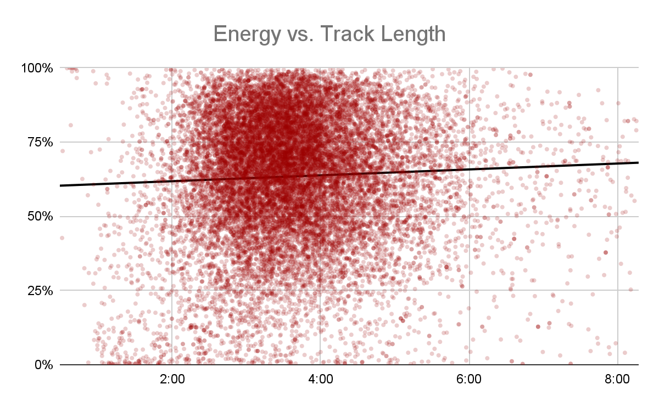
Are long tracks different?
Notes:
Two scatter plot charts showing the comparison of average energy, danceability, and tempo between song above and below the median duration. Longer songs seem to show higher average energy while shorter songs have a slightly higher danceability and tempo with very minimal differences in general.

Slide 4
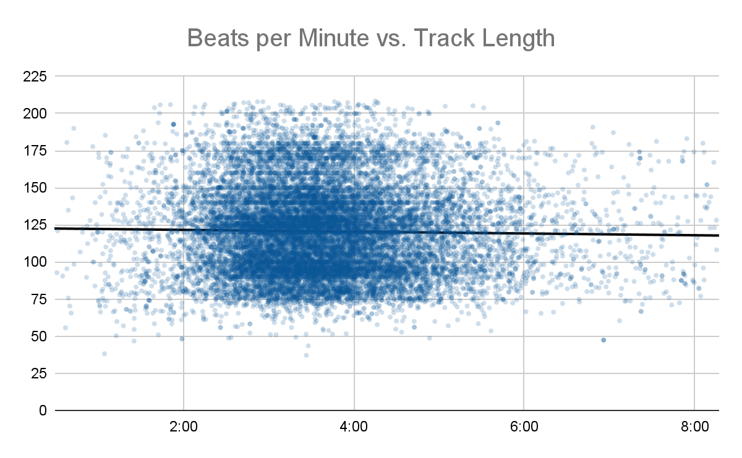
Are long tracks different?
Notes:
Two scatter plot charts showing the comparison of average energy, danceability, and tempo between song above and below the median duration. Longer songs seem to show higher average energy while shorter songs have a slightly higher danceability and tempo with very minimal differences in general.

Slide 5
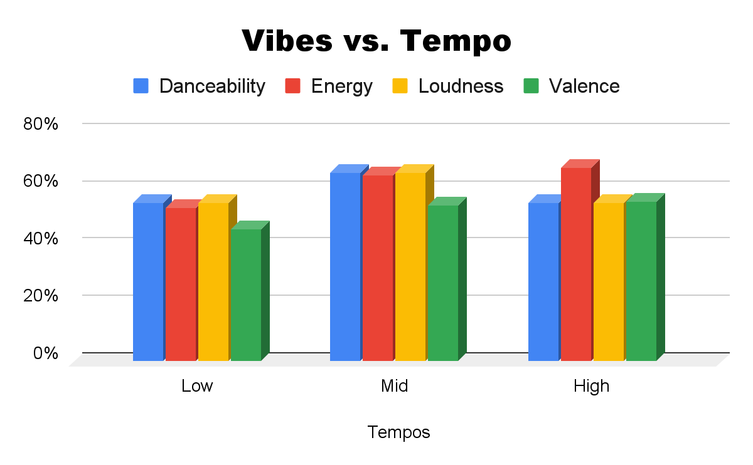
Are fast or slow tracks different?

Slide 6
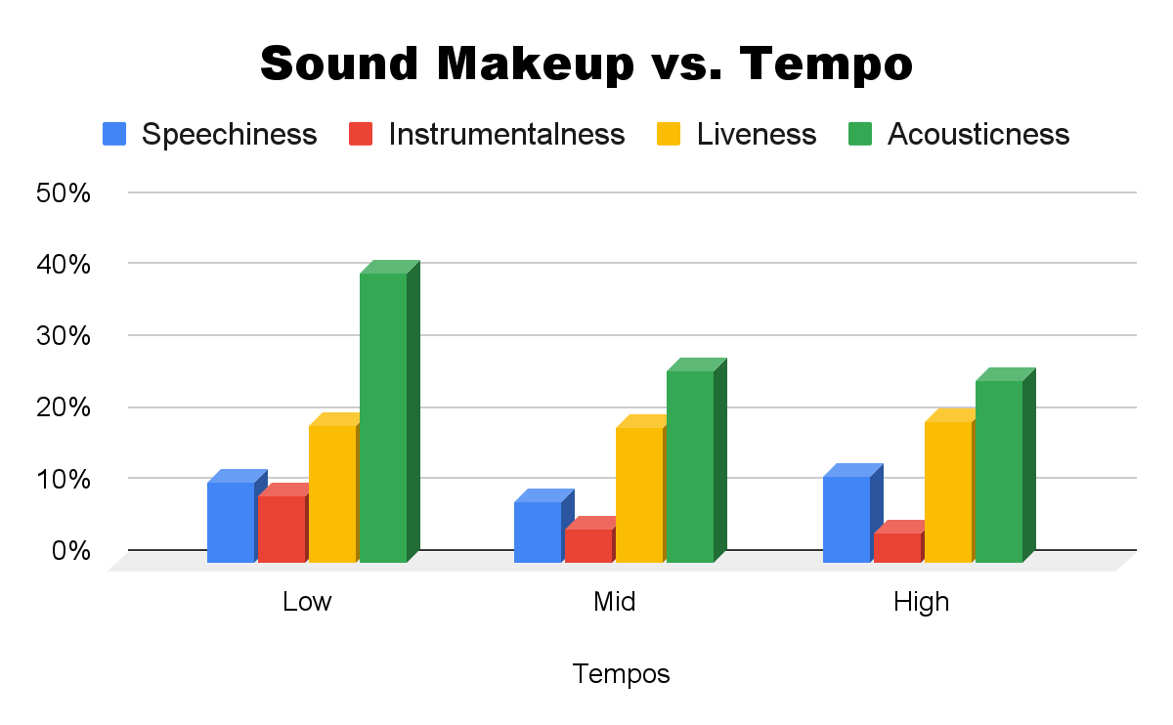
Are fast or slow tracks different?

Slide 7
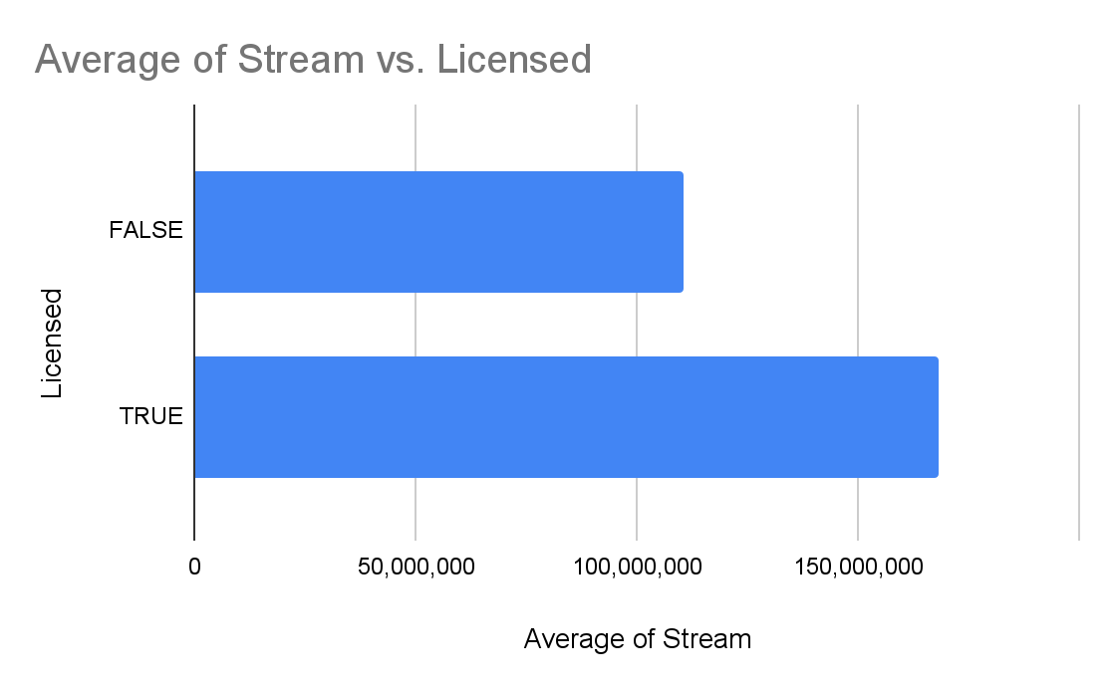
Are licensed videos more popular?
Notes:
A bar graph showing the popularity in Spotify streams of tracks whose YouTube videos were licensed or unlicensed. The licensed tracks average just over 150 million streams, while the unlicensed tracks average just under 100 million streams.

Slide 8
DATASET CLEANING
We removed these from the original dataset:
471 tracks (2.3%) for lacking Spotify or YouTube data
556 tracks (2.7%) lacked streaming data (excluded only from the last question)
1759 rows (8.4%) of data that were duplicates caused by collaborations

Slide 9
THANK YOU!
Questions?
DATASET: “Spotify and Youtube” by Salvatore Rastelli, Marco Sallustio, and Marco Guarisco, sourced from Kaggle on 2/11/26 from https://www.kaggle.com/datasets/salvatorerastelli/spotify-and-youtube

